Slide 1
Understanding Autism
An Introduction to the Characteristics and Treatment of Autism Spectrum Disorders
Peggy Halliday, M.Ed., BCBA
October 2, 2012
SOMA/COMA Conference, Richmond, VA

Slide 2
CDC reports that an average of 1 in every 88 children has an Autism Spectrum Disorder (ASD)
Centers for Disease Control [CDC], (2011)

Slide 3

Questions
What is autism?
How is it diagnosed?
Who has it?
What are the characteristics?
What are the treatment options?

Slide 4
AUTISM SPECTRUM DISORDER

Slide 5
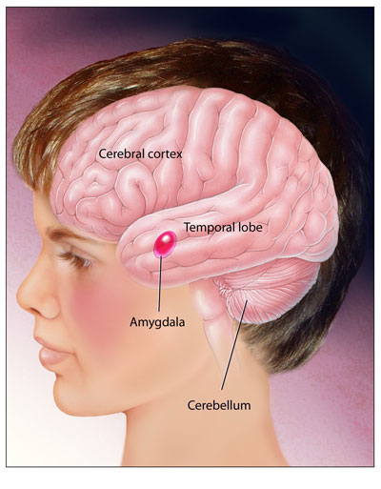
A developmental disorder that affects the functioning of the brain
http://www.sfn.org/skins/main/images/brainbriefings/bb_May2006_large.jpg

Slide 6
The Autism Spectrum
Autism is used as an umbrella term to include several disorders on the autism spectrum, the most common of which include:
  Autistic Disorder (Classic Autism)
  PDD-NOS
  Asperger Syndrome

Slide 7

Diagnosis of Autism
Based on behavioral evaluation, not medical testing
Diagnostic criteria are in Diagnostic and Statistical Manual of Mental Disorders (DSM-IV-TR)
Can be accurately diagnosed in infants as early as 18 months
(APA, 2000; CDC, 2007)

Slide 8
Diagnosis of Autism in Children with Visual Impairments
Salt (2010):
No published tools for diagnosing ASD in visually impaired children
Must modify the standard diagnostic criteria to take account of the expected behaviours in visually impaired children
Must involve a multi-disciplinary professional team that has expertise in both visual impairment and ASD
Unusual to diagnose before the age of 5

Slide 9
Diagnosis of Autism in Children with Visual Impairments
Macleod and Curtis (2010):
Diagnosis of an ASD can be a relief for parents as it helps them to understand their child more fully
Very important that assessments lead to intervention plans which are implemented
Early assessment for ASD alongside visual impairment can result in interventions at home and school which transform life for the child and the family

Slide 10
Diagnosis of Autism in Children with Visual Impairments
Macleod and Curtis (2010):
Diagnosis of an ASD can be a relief for parents
Very important that diagnosis lead to intervention plans which are implemented
Early assessment for ASD alongside visual impairment can result in interventions at home and school which transform life for the child and the family

Slide 11
Diagnosis of Autism
Autism is a developmental disability, it is not caused by parents, it is not induced by blindness
Autism is a spectrum disorder, with a wide range of functional levels and associated behaviors
While symptoms may show improvement, autism is a LIFELONG disorder
Most individuals will continue to need some level of support throughout their life time
(APA, 2000; CDC, 2007)

Slide 12
Diagnosis of Autism in Children with Visual Impairments
Chess (1971). Journal of Autism and Childhood Schizophrenia
“Nonautistic youngsters … are very alert to their surroundings through their other senses, especially exhibiting alertness and appropriate responsiveness... one is impressed by their readiness to respond to appropriately selected and carefully timed overtures.
…the autistic children neither explore alternative sensory modalities nor manifest appropriate responsiveness. They form a distinct group whose distance from people cannot be adequately explained by the degree or combination of visual and auditory loss…., their affective behaviors do not resemble those of children of their obtained mental age – in fact, there is no mental age for which the behaviors are appropriate.”

Slide 13
Diagnosis of Autism in Children with Visual Impairments
Key Issues:
Visual impairment is usually diagnosed first (at birth or first few months of life)
Children with ASD may start life with sight but lose sight from illness or accident
Children with ASD may lose sight through self-injury

Slide 14
Autism Facts
The causes of autism are unknown
There is no cure
People with autism have normal life expectancies
Occurs in all racial, ethnic, and socioeconomic groups around the world
(APA, 2000; CDC, 2007)

Slide 15
Autism Spectrum Disorders
1 in every 88 school age children diagnosed with autism
5 times more common in boys (estimated 1 in 54 boys)
Autism can be accurately diagnosed in infants as early as 18 months, but most are diagnosed at 4 ½
4th largest primary disability category on the Dec. 2010 child count
Definitive research shows early and intensive supports leads to improved outcomes

Slide 17
Autistic Disorder (Classic Autism)
Characterized by serious impairments in social interaction and communication and by unusual behavior and interests
(APA, 2000; Centers for Disease Control [CDC], 2007)

Slide 18
Impairments differ in each individual
  Lifelong

Slide 19
“Savant “ skills are rare
40-50% of people with autism also have diagnosis of an intellectual disability

Slide 20
Three core dimensions of autism
Social
Communication
Restricted
interests

Slide 21
Social Challenges
http://blog.mlive.com/bctimes/2008/04/autism-registry01.jpg

Slide 22
May avoid eye contact and want to be alone
Lack of facial expression, gestures, nonverbal cues
(APA, 2000; CDC, 2007)
http://www.beagooddad.com/wp-content/uploads/2007/06/bagdpookieandpapaw.jpg

Slide 23
Lack of spontaneous shared attention
Failure to develop peer relationships

Slide 24
Communication Challenges
http://bkmacdaddy.com/blog/wp-content/uploads/2009/12/angry.jpg

Slide 25
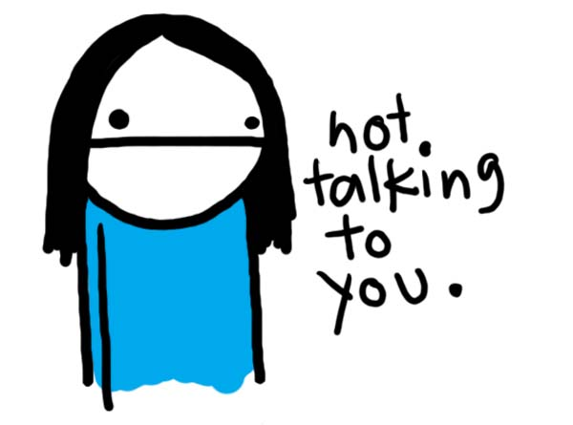

Slide 26
Limited, delayed, or absent speech
Stereotypic, repetitive use of language (echolalia) or idiosyncratic language
(APA, 2000; CDC, 2007)

Slide 27
May give unrelated answers to questions
Literal interpretation of language
Problems with personal pronouns
Not able to sustain a conversation
(APA, 2000; CDC, 2007)

Slide 28
Behavior
http://babble.com/CS/blogs/strollerderby/2007/08/08-15/tantrum-child.jpg

Slide 29
“Restricted repetitive and stereotyped patterns of behavior, interests, and activities”
(APA, 2000, p. 75)

Slide 30
Repetitive, purposeless, driven motor movements
May flap their hands, rock their body, or spin in circles
(CDC, 2007; APA, 2000, p. 75)

Slide 31

Upset by Changes

Slide 32
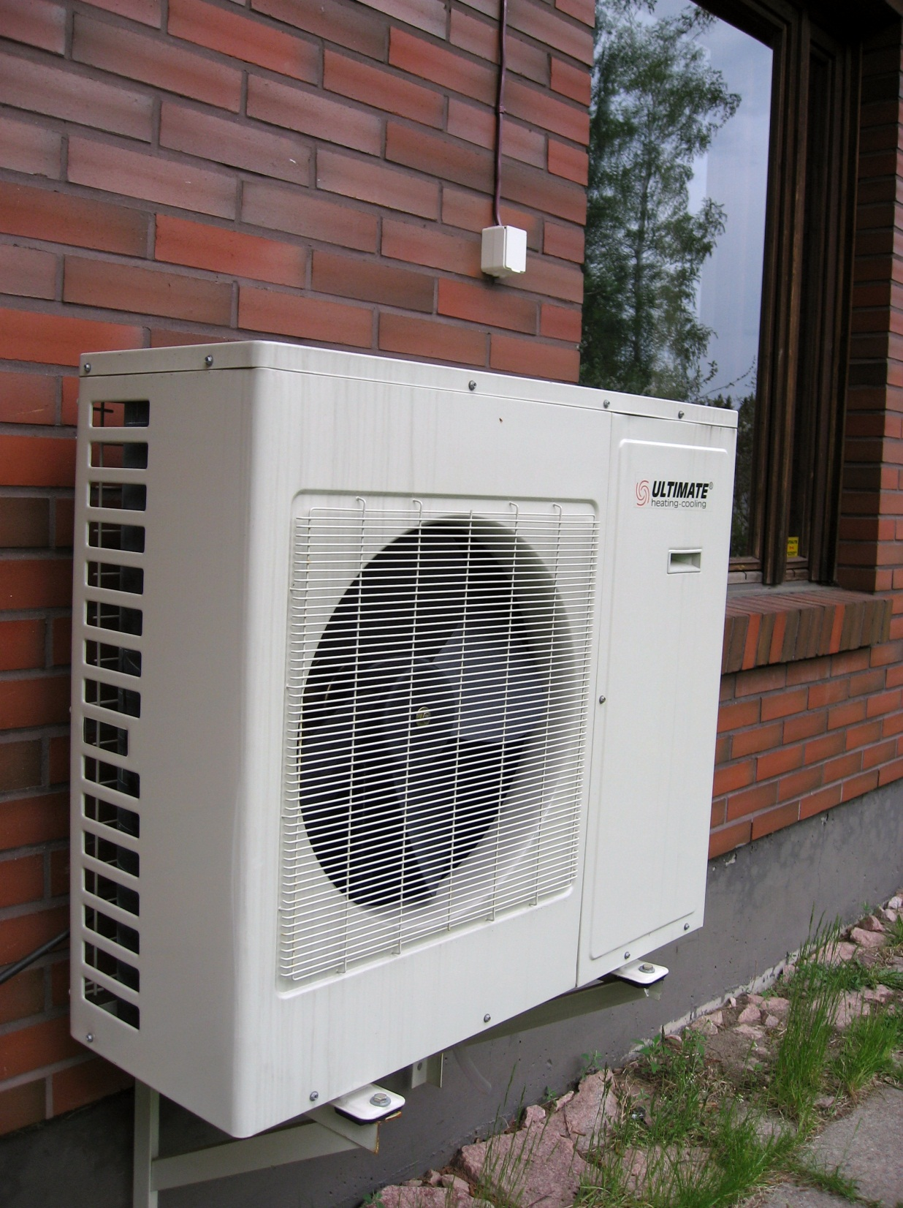
Preoccupation with particular items or with parts of objects
Preoccupation is intense or the focus is odd

Slide 33
“Inflexible adherence to specific, nonfunctional routines or rituals”
(APA, 2000, p. 75)

Slide 34
There may also be…
Hyperactivity
Impulsivity
Aggressive, self-injurious and/or tantrum behavior
(APA, 2000; CDC, 2007)

Slide 35
Abnormal emotional reactions/moods
Restricted diets; pica
Sleeping difficulties
Lack of awareness of dangerous situations
Fear of objects that are not dangerous
Chronic gastrointestinal problems

Slide 36
Keep in mind…
Every Person with Autism is Different

Slide 37
….and
Behaviors are likely to change over time

Slide 38
Asperger’s Syndrome is similar in many ways...
http://www.lucasworks.org/autistic-child.jpg

Slide 39
Like classic autism, Asperger Syndrome is a lifelong neurological disorder that affects a person’s ability to communicate and relate to others.
Marked by impairments in:
  Socialization
  Communication
  Behavior
  Sensation

Slide 40
Social Challenges
Confused by social cues and subtleties
Focus on obsessive and narrowly defined interests that may not be of interest to others
Difficulty with reciprocal conversation
Tendency to speak bluntly: no regard for impact of words on others
Literal interpretation words

Slide 41
Communication Challenges
Difficulty understanding sarcasm or metaphor
Echolalia
Poor judge of personal space – may stand too close to others
Abnormal inflection and eye contact
Inappropriate facial expressions or gestures
Difficulty interpreting nonverbal communication cues

Slide 42
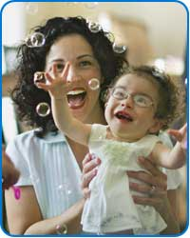
When visual impairment and autism occur together, each disability impacts the other.

Slide 43
Social Challenges in Children with Visual Impairment and Autism
May fail to engage in reciprocal interactions
May treat others as though they were objects
May have no interest in peers
May not be able to process multiple sensory stimuli simultaneously

Slide 44
Implications for Parents and Educators
Recognize that the social world is more complex and less predictable for an individual with autism, and therefore more anxiety producing.
Simple exposure to peers will not result in the acquisition of social skills.
A child can be taught to acquire social skills. Begin with something short, structured, teacher directed, and success oriented.

Slide 45
Speech Challenges in Children with Visual Impairment and Autism
Students may seem very verbal but can't follow instructions due to poor receptive language
  May use words expressively which they don't really understand (receptive language lower than expressive)
Echolalia (a positive sign in that it shows that the child is at least discriminating among phonemes, sequencing sounds, using working memory)
Pronoun reversal
May be non-verbal

Slide 46
Implications for Parents and Educators
Must check out whether child understands what he/she is saying.
Use limited language: short, concrete phrases with time between statements to allow for processing.
If student has vision, try to provide some information visually; if not, provide information tactually.

Slide 47
Communication Challenges in Children with Visual Impairment and Autism
May perseverate on one topic
May show no interest in other people's interests
May be too close or too far away when talking
May say something unrelated to the conversation
May become angry when he hears certain words
May have problems with impulse control
May not be able to to take the perspective of another, as well as problems shifting attention

Slide 48
Implications for Parents and Educators
Direct instruction in the actual setting is key (generalization).
Identify clear, concrete rules that the child needs to follow in specific situations.
Social stories can be helpful in providing a child with a script to follow.

Slide 49
Behavioral Challenges with Visual Impairment and Autism
Need for sameness, predictability
  Repetitive events are easier to understand
  Repetitive behavior may be experienced as soothing
Motor stereotypies
Focuses on parts of objects in play (e.g., wheels, spins everything, flips handle of basket repeatedly)
Age appropriate pretend play not observed
Restricted and perseverative interest (e.g., elevators, Xerox machines, CD titles)

Slide 50
Implications for Parents and Educators
Recognize that the routines and self-stimulatory behavior are the things that the child understands best and may serve as a “comfort zone“.
The child's reliance on such behaviors will tend to increase in times of stress and anxiety (e.g., transition, lack of clear expectation, challenges).
Identify a time when the child can engage in his self- stimulatory behavior; tighten up the structure, schedule, routine to decrease anxiety and increase non-verbal information.

Slide 51
Sensory Challenges in Children with Visual Impairment and Autism
May over-react to certain noises (e.g., fire-alarms, vacuum cleaner, fan motors)
May find certain tactile experiences aversive (e.g., certain foods, texture of clothing, soft furry objects, being touched)
May not react to pain (bumping head, falling down, etc.)
May stop listening to instructions when asked to do something else
  May only be able to process one sensory input at a time
May process temperature, texture, multi-sensory things differently

Slide 52
Implications for Parents and Educators
Be alert to how the sensory environment may be impacting on your student.
Try to keep the environment as low key as possible (e.g., visually clear, sound absorbing materials, no extraneous noise or conversation; balance lighting needs for children's visual impairment with those of arousal).
Be aware of possible multi-sensory input issues and adjust instruction accordingly.
Teach gradual desensitization to aversive sensory situations

Slide 53
Treatment of ASDs
Early intervention is important and preferred
Most individuals with ASD respond well to highly structured, specialized programs
There are many methods available for treatment and education of people with autism. Most have no peer reviewed research to support them.

Slide 54
Guidelines for Considering New Treatments
Be wary of exaggerated claims of cure
Be wary of treatments requiring intense commitments of money
Be cautious of treatments that could be physically harmful, and always consult a doctor
Notes:
When you consider a new treatment, or any treatment, look out for exaggerated claims of cure, especially if the treatment requires intense commitment of time, energy, and money. Remember that no one will advertise a treatment with testimonials saying that it does not work—be aware of the marketing aspect of what you read.
Finally, keep in mind that there is no cure for autism. Use caution when considering a treatment that claims a cure.
Be cautious of treatments that may cause direct physical harm to your child. Always consult with a pediatrician when pursuing biomedical treatments such as a special diet or vitamin supplements.

Slide 55
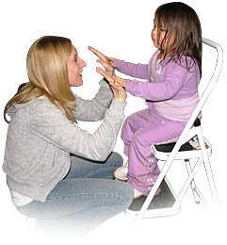
The primary evidence-based treatment for autism is intensive, structured teaching
Applied Behavior Analysis
(ABA)
http://kresa.schoolwires.com/1057103268305827/lib/1057103268305827/croydenpreschool.jpg

Slide 56
Why Evidenced-based?
It is difficult for families to determine which interventions to pursue, given the many contradicting opinions they will hear
Competing information, competing ideologies, and misinformation
  Misinformation: false claims, over-statements, or misleading statements
An informed choice is a freely made choice!

Slide 57

Great Resource
Association for Science in Autism Treatment
  www.asatonline.org
  Distributing free e-newsletter, Science in Autism Treatment
  Facebook page
    http://www.facebook.com/ASATonline
Notes:
57

Slide 58
A Few Tips on Best Practice for Students with ASD

Slide 59
ARRANGING THE ENVIRONMENT FOR SUCCESS
Please share your ideas!

Slide 60
Why do we need to modify the environment for students with ASD?

Slide 61
Specialized Characteristics of Autism
(Holtz et al., 2004)
Need for sameness/difficulty with transitions
Problematic behavior
Distracted by sights/sounds
Sensitivity to touch
Sensitivity to smell
Sensitivity to sounds
Sensitivity to lights

Slide 62

Prepare Your Space
Use your knowledge of your
students’ characteristics to alter
physical aspects of the classroom.
Proper classroom / home arrangement will help ensure on-task behavior, increase independence and lessen anxiety.

Slide 63
Accommodating a Need for Sameness
Define classroom areas
  1:1 teaching, group work , independent work spaces
Keep classroom consistently organized
  Free the environment of clutter
Use both classroom and individual schedules

Slide 64
Accommodating a Need for Structure
Define classroom areas: What activity should take place in each area?
  1:1 teaching, group work , independent work spaces
Keep classroom consistently organized
  Free the environment of clutter
Use both classroom and individual schedules

Slide 65
Accommodating Need for Visual Supports
Post classroom schedule in consistent place and reflect any upcoming changes
Individual picture or textual schedule stays with student to show in advance of transitions

Slide 66
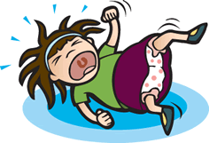
Accommodating Students with Problematic Behavior
Have recreation areas for students to be active
Have “home base” area for students to escape classroom stimulation
Be aware of safety
concerns

Slide 67
Accommodating Students who are Easily Distracted
Face desks away from windows and doors, high traffic areas, and play materials
Use carpet / tennis balls on chairs
Cover computer or teach when it is available
Minimize outside distractions
Desensitize to distractions over time
Give SIMPLE directions + visual aids
Make sure schedule is well-rounded with a variety of short activities

Slide 68
Accommodating Sensory Sensitivities
Recognize differences in processing sensory stimuli
Do not force children into aversive sensory situations unless absolutely necessary
Look for environmental accommodations
Use systematic desensitization to teach tolerance
Ensure appropriate sensory activities are available

Slide 69

Accommodating Sensitivity to Touch
Know student’s
tolerance for touch
Use alternative
prompting when
possible
Desensitize to touch
over time

Slide 70

Accommodating Sensitivity to Smells
Avoid perfumes and scented lotions
Seat student near open door/window in areas with strong smells (art room, cafeteria)
Use unscented cleaning supplies if necessary

Slide 71
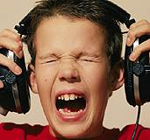
Accommodating Sensitivity to Sounds
Use soft, calm voice
Use carpeting
Put material under desk/chair legs
Prepare student for loud sounds
(bells, fire drills)
Have ear plugs/headphones available
Desensitize to sounds over time
Quiet space is provided for break areas

Slide 72
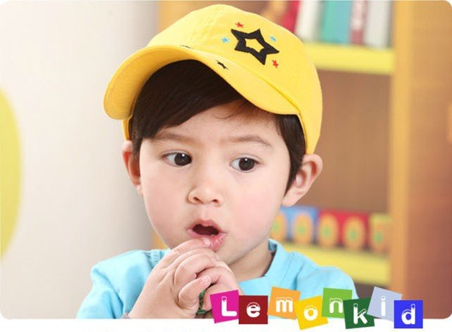
Accommodating Sensitivity to Lights
Use lamps instead of fluorescent lights
Try lower light or different colors
Offer student sunglasses or baseball cap

Slide 73

Other Antecedent Strategies
Alter response effort/manipulate tasks and task difficulty
Change schedules/times of day
Provide CHOICE
More engaging tasks
Make sure materials are
age-appropriate

Slide 74
Be Consistent Across Child’s Team!
Regular team meetings for updates/troubleshooting
Written plans for teaching, addressing challenging behavior, etc.
Training and observation
Consistency across team regarding:
  Student characteristics
  Teaching procedures
  Level of demands
  Behavior support plans

Slide 75
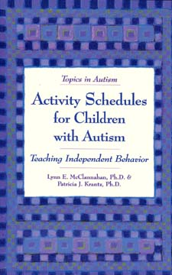
ACTIVITY SCHEDULES

Slide 76
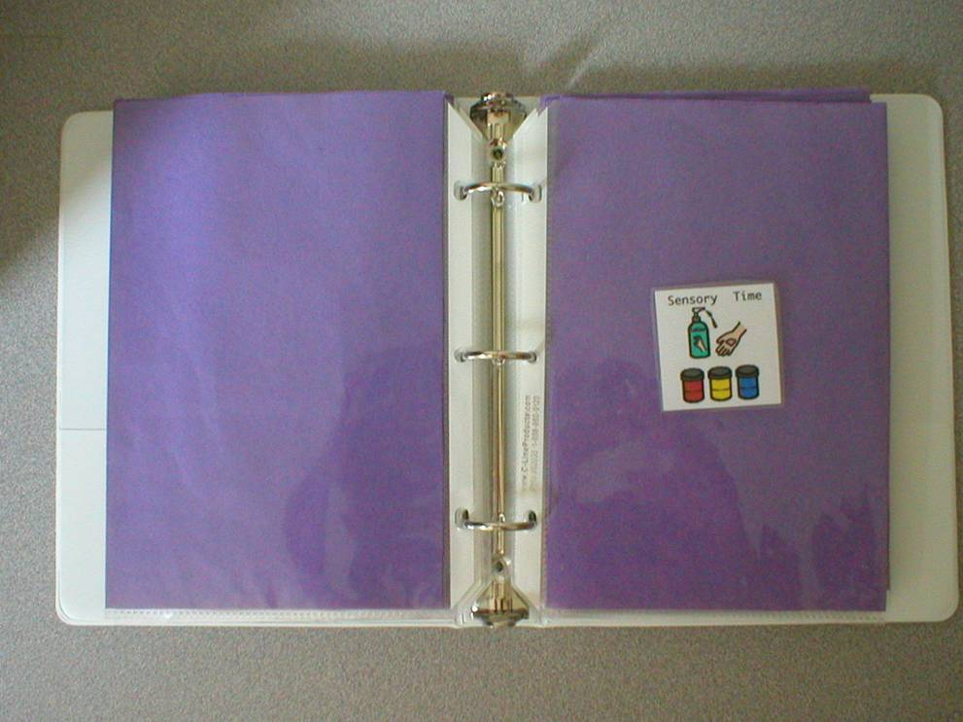
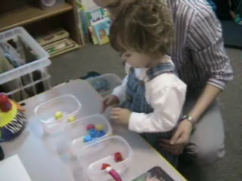
What is an Activity Schedule?
“A set of pictures or words that cues someone to engage in a sequence of activities”
(McClannahan & Krantz, 1999)

Slide 77
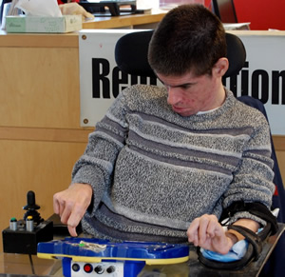
Activity Schedule
Tells student:
What I am going to do
For how long?
What comes next?
When will I be finished?
How this helps:
Minimizes demands on memory and attention
Decreases problems with time and attention
Helps avoid problems with language comprehension
Aids motivation
Promotes independence

Slide 78
Why use activity schedules?
Organize the environment
Reduce anxiety
Help with transitions
Increase independence
Provide framework for choice
Portable
Don’t necessarily need to fade

Slide 79
Activity Schedule Uses
Individual Daily Schedules
Classroom Routines
Personal Hygiene Routines
Chore Lists
Independent Leisure Schedules
Vocational Tasks

Slide 80
First Independent Activity Schedule
Between 2 and 4 activities
Mastered, independent activities
Preferred or neutral activities
Activities with a definite beginning and end
End with most preferred activity

Slide 81
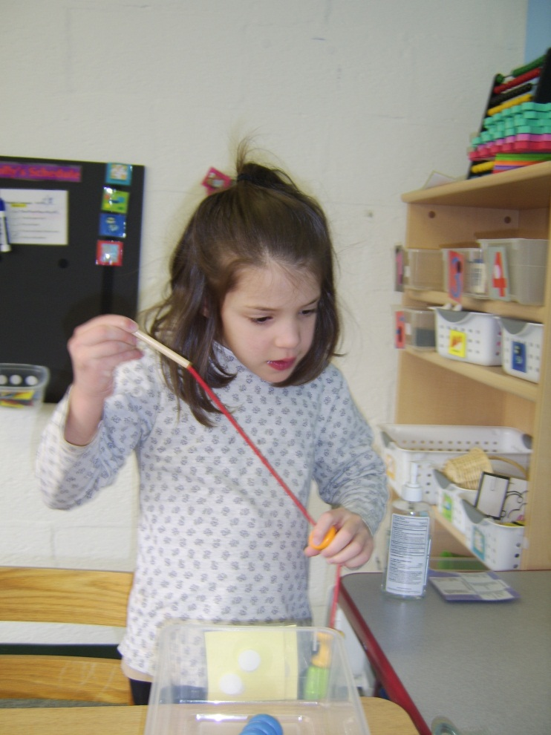
Sample First Independent Schedule for a Young Student
Review folder for matching colors
Shape sorter
Peg puzzle
Snack

Slide 82
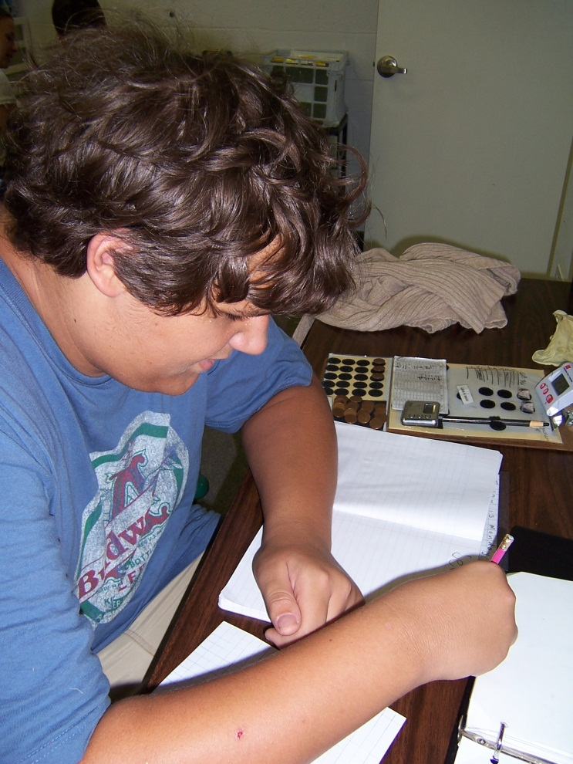
Sample First Independent Schedule for an Older Learner
Skill-appropriate book
Jigsaw puzzle
Math review worksheet
Snack

Slide 83
REINFORCEMENT
Notes:
Introductions

Slide 84
“Reinforcement is one of the most critical elements of therapy.”
(Leaf et al., 1999)

Slide 85
Reinforcement
Definition:
A procedure that follows a behavior, and INCREASES the likelihood of the behavior occurring in the future
Defined by its effect, not by your intention

Slide 86
Reinforcement for Children with Autism
Social reinforcers may not be motivating
Typical activities may be stressful because they:
  Are new
  Are different from the routine
  Require social interaction
  Involve sensory input that is uncomfortable
Students with ASD may have very little control over their environment

Slide 87
We need to use more direct, tangible reinforcement to motivate and reward students with autism

Slide 88

Identifying Reinforcers
A reinforcer can be anything….
  A laugh
  Computer time
  Candy
  Toys
  Tickles
  A warm puppy

Slide 89
A Note of Caution about Reinforcers
Reinforcers need to be determined for each person individually
What is reinforcing for one person may not be reinforcing for another
Reinforcers change from day to day; moment to moment
Notes:
We have discussed the two types of reinforcers, but what determines whether or not a particular item will serve as a reinforcer and in fact result in a future increase in the behavior? Several points to consider include..
Reinforcement is unique to each person. For example, jellybeans are not a universal reinforcer for all three-year olds.
What is reinforcing for one person may not be reinforcing for another. In other words, I might find reading to be reinforcing, whereas you might prefer to watch a movie.
Reinforcers need to be determined for each individual separately.
Finally, reinforcers change from day to day.
Now let’s talk about ways to determine individual reinforcers.
{{NEW SLIDE}}

Slide 90
ADDRESSING CHALLENGING BEHAVIORS

Slide 91
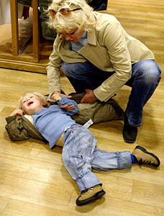

There are many deficits present in autism that predispose a student to engage in problematic behavior (Gerhardt, 2004)
Limited access to reinforcement
Low tolerance for change
Difficulties with unstructured time
Restricted leisure skills repertoire
Selective attention by staff
Confusion
Difficulties with waiting or delaying reinforcement
Poor environmental congruence
Inability to exercise appropriate control over environment

Slide 92
“Maladaptive” Behavior
All behavior is adaptive for the person engaging in it.
Every behavior serves some purpose.
It is clinically unsound to implement an intervention to decrease a behavior until you know the function of the behavior.

Slide 93
Every behavior has a function,
it is our ethical responsibility to do everything we can to discover it.

Slide 94
Four Categories of Functions of Behavior
Access to attention
Access to preferred items (activities, tangibles)
Escape or avoidance of aversive stimuli (pain, work, social demands)
Sensory stimulation (it just plain feels good)

Slide 95
Examples:
Attention | Preferred Items | Escape/ Avoidance | Sensory Stimulation
Jack is doing head stands in front of the TV to try to gain attention from his brother. | Jack tantrums to gain access to some cookies. | Jack leaves the room to avoid Dad’s discussion about college. | Jack is repeatedly tapping his cheek while relaxing on the couch

Slide 96
To Decrease Problem Behaviors…
DON’T REINFORCE THEM!

Slide 97
Reinforcement
The tricky thing about reinforcement is:
If a behavior continues to occur, it is being reinforced in some way!

Slide 98
Reinforce a desirable behavior that the student already has
Teach a new desirable behavior:
  A replacement that serves the same function
      and/or…
  An alternative that doesn’t serve the same function but that allows the student to be reinforced more often

Slide 99
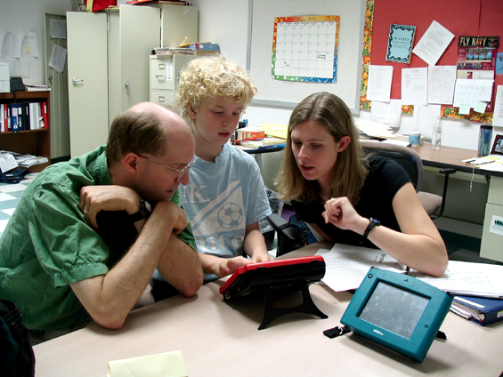
Teach functional communication skills…
  To replace the function of the problem behavior
  Using a form of communication based on the student’s needs (Examples: sign language, PECS, augmentative device, verbalizing)

Slide 100
  Keys to successful functional communication:
  It must…
  Be EASY
  Be FAST
  Require LITTLE EFFORT
  Be rewarded IMMEDIATELY
  Be rewarded CONSISTENTLY
  Be rewarded EVERY TIME
  Worry about teaching the student to tolerate delayed or denied access LATER. And even then, do it GRADUALLY!

Slide 101
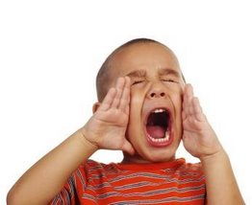
Your turn…
As you stand chatting with another instructor in the classroom, your learner is repeatedly yelling out your name.
What do you think is the function of this behavior?
What should you do (in this moment) in response to the behavior?
What replacement behaviors can you think of teaching this learner?

Slide 102
If you guessed “Attention Seeking” you are correct.
Your first intervention would be to withhold your attention.
And here are some potential replacement behaviors for this learner:
  Learning to wait
  Learning to raise a quiet hand
  Learning to say “Excuse me”
  Learning to ask for help
  Learning to approach an adult and tap them on the shoulder

Slide 103
Generalization

Slide 104
Generalization is…
The exhibition of a skill under novel circumstances
The ability to use a skill independently and in typical settings

Slide 105
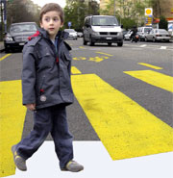
Many learners with autism never learn skills well enough to make them functional.
Skills are acquired only under very specific circumstances, with certain people, and with certain stimuli.
In order to be functional, a skill must be generalized.

Slide 106
General Tips:
Use brief statements, moderating the pace of speech; pace of exploration of object.
Control the amount & type of input so child is not over aroused, unable to attend.
Be aware of impact of even subtle noise on child’s stress level and ability to attend.

Slide 107
General Tips:
Balance social time with alone time. Child may often find social experiences aversive rather than reinforcing.
Social experience is generally not important to child. Praise, “time out,” are typically not effective motivators.

Slide 108
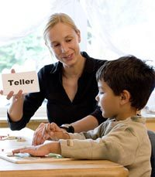
Discrete Trial Instruction
A methodology of teaching that research consistently shows to be one of the most effective and efficient means of teaching new skills
Most appropriate with acquisition level skills
Most effective 1:1 but can be used in group formats

Slide 109
Discrete Trial Instruction
Skills are broken into smaller parts, with one part taught at a time
Each teaching session involves repeated trials; each trial is “discrete” (has a specific beginning and end)
One trial: instruction or cue (SD), a prompted or independent response, and a consequence (correction or reinforcement)
Correct responses are reinforced, with greater reinforcement for independent responses
Prompts are faded as quickly as possible

Slide 110
Discrete Trial Instruction
Data are collected
Skills may be taught one item at a time or in sets
Errorless teaching or “no-no-prompt” teaching may be used
Massed trials of 15-30 trials are sometimes used in initial teaching
Once a skill is mastered it may be embedded into the daily schedule and practiced in a variety of settings, including the classroom

Slide 111
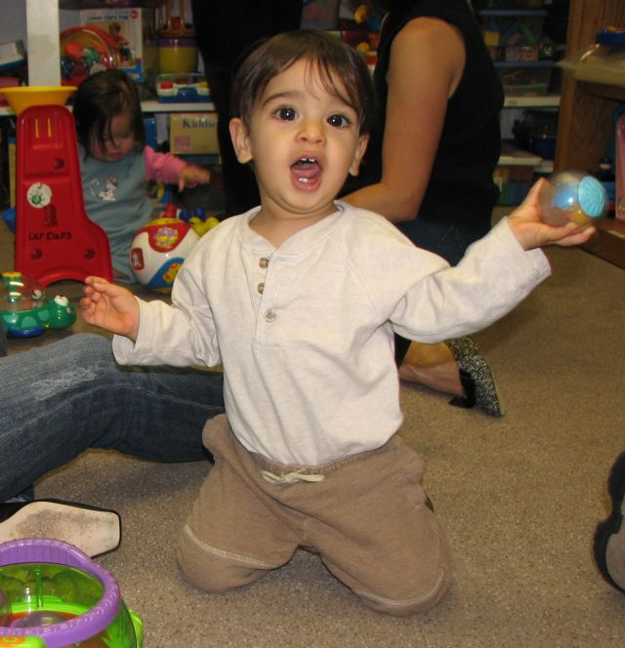
Incidental Teaching
Child-directed teaching
The child initiates the interactions
The teacher may set up interesting situations or manipulate the environment to attract the child’s attention

Slide 112
Incidental Teaching
There are 3 necessary elements in incidental teaching:
  The student initiates communication
  The adult requests an elaboration
  The adult reinforces the elaboration or models correct behavior

Slide 113
Incidental Teaching
It appears incidental but is actually highly structured and planned
It can take place in any setting; most often it is used in free play or activity times
Adult responsiveness is critical to its success: the adult must be aware of the student’s performance level, of when to raise the bar and not over-accommodate the learner

Slide 114
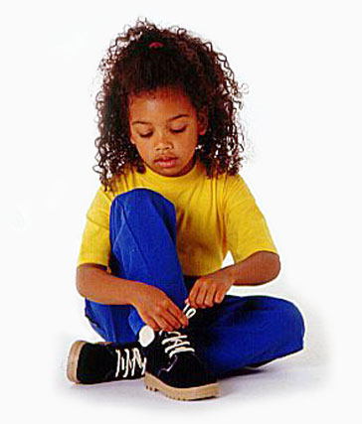
Task Analysis Instruction
A task analysis is a detailed analysis of a larger goal
Goal is broken into manageable steps and taught through shaping or chaining
Each step cues the next step

Slide 115
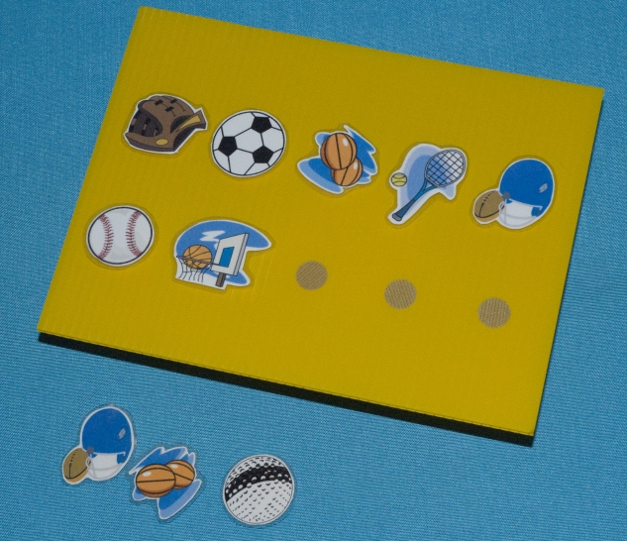
What Do These Teaching Strategies Have in Common?
Take into account the learning challenges associated with autism
Break down skills into small steps
Use lots of positive reinforcement
Use an individualized motivation system
Use teaching procedures that mix fun and play with short periods of work

Slide 116
Discovery Learning
Very popular in regular education settings
Based on the assumption that:
  students are observational learners
  students are active problem solvers
  motivation is largely internal

Slide 117
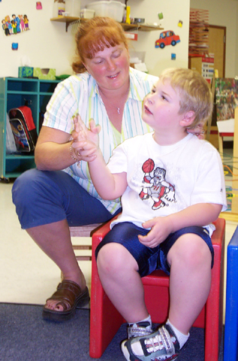
When you use behavioral methods rather than discovery or observational learning…
You’ll find your student acquiring new skills in
an atmosphere that is
pleasant…
And where frustration is
not a constant part of
the learning process.

Slide 118
Thank you!
Peggy Halliday
phalliday@viaschool.org

